Slide 1

Presented By: Atul Ezrelle Indu Tianyue

Slide 2

Project Overview
The Framingham Heart Study dataset provides various valuable insights into the risk factors associated with coronary heart disease over a ten-year period. This project aims at analyzing key variables and their association in the incidence of Ten Year Coronary Heart Disease (CHD).
Notes:
Our data was collected from kaggle and gave various information on sub populations and data that affects Coronary heart disease. Our goal was to analyze these key variables.

Slide 3
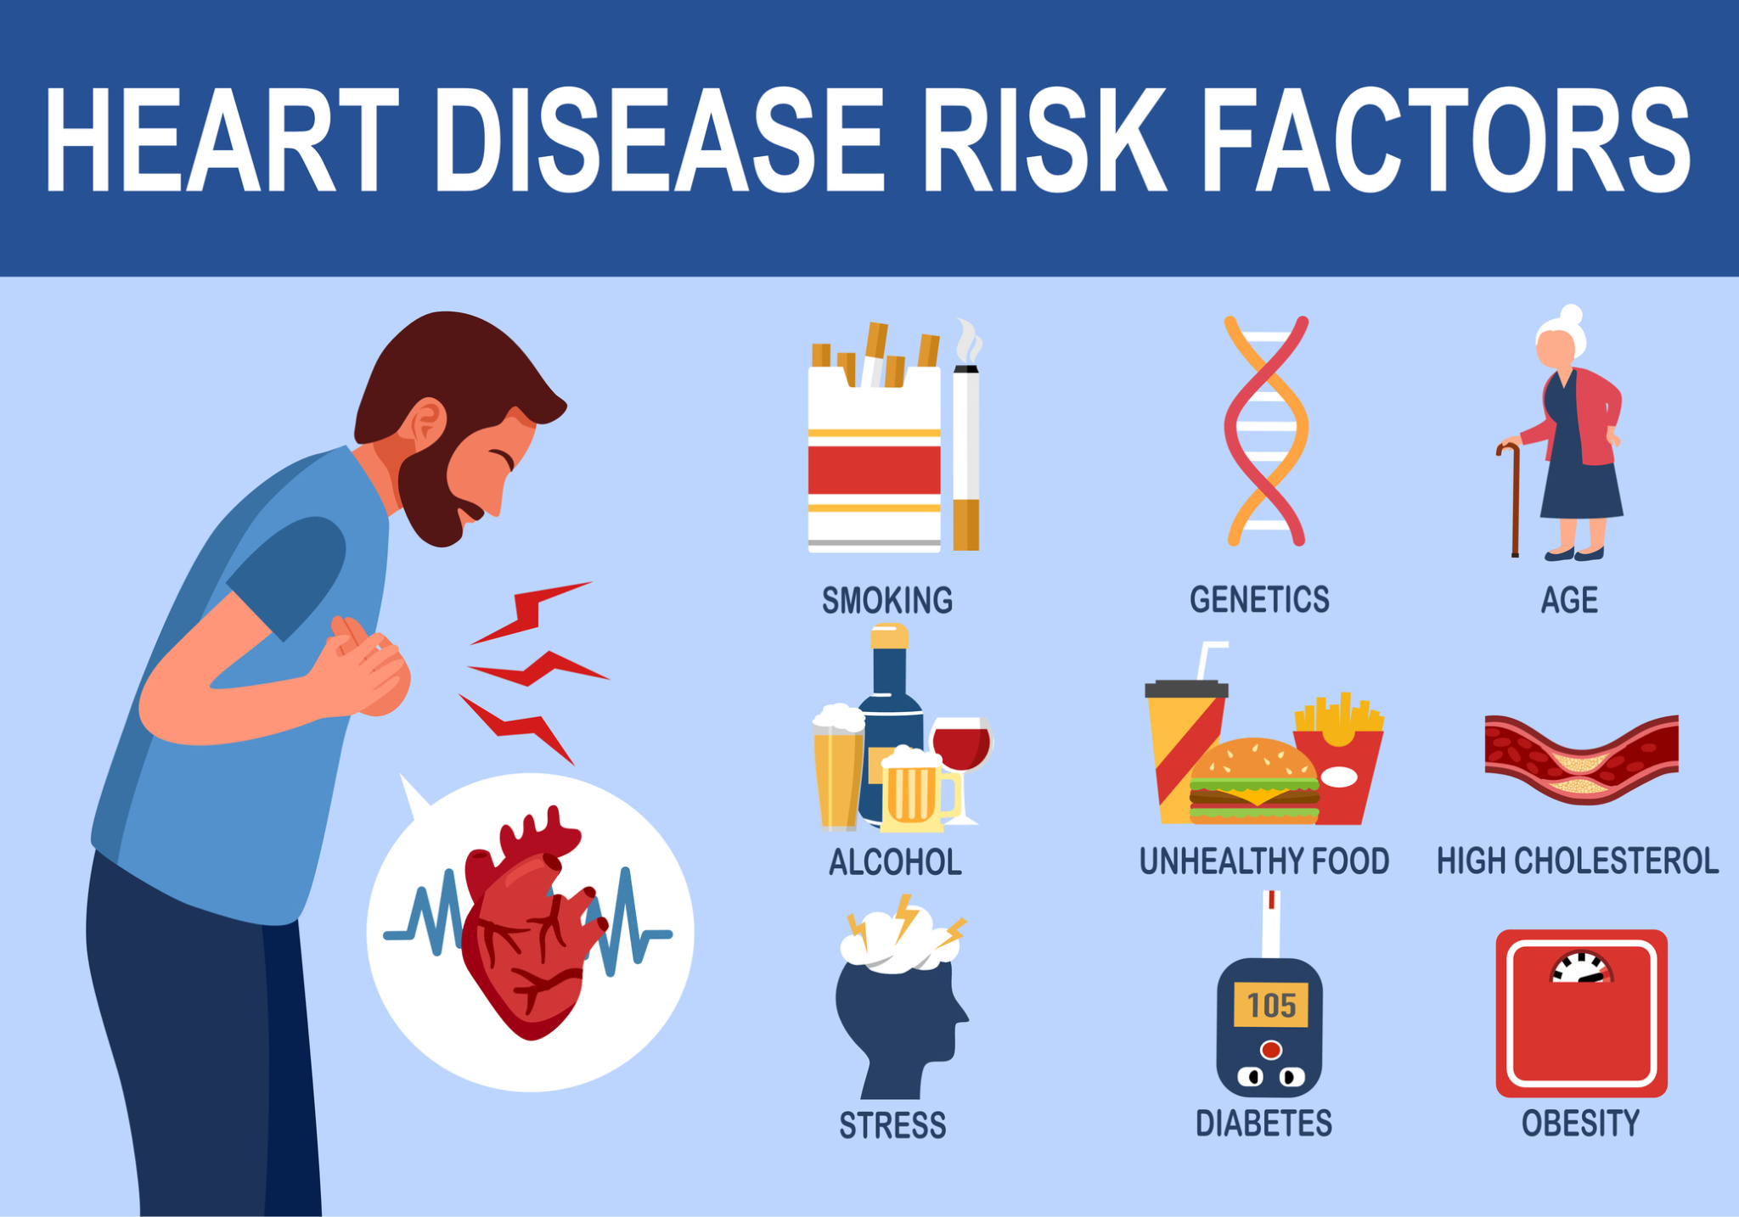
Research Questions
Cigarette impact heart disease
Gender based Diabetes correlation with heart disease
BP Med impact to heart disease
Effect on gender to heart disease
Impact of Stroke and Hypotension on heart disease

Slide 4
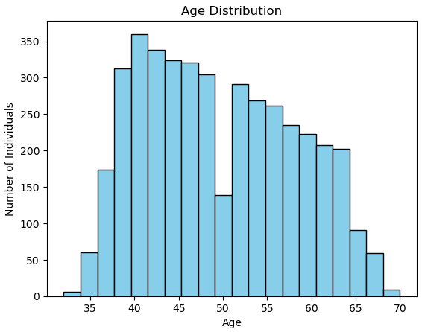
Our Data Set is an Older Population
Notes:
From the age histogram we can see that most of our population is full of older millennials, gen x, and boomers. (Quick Slide)

Slide 5
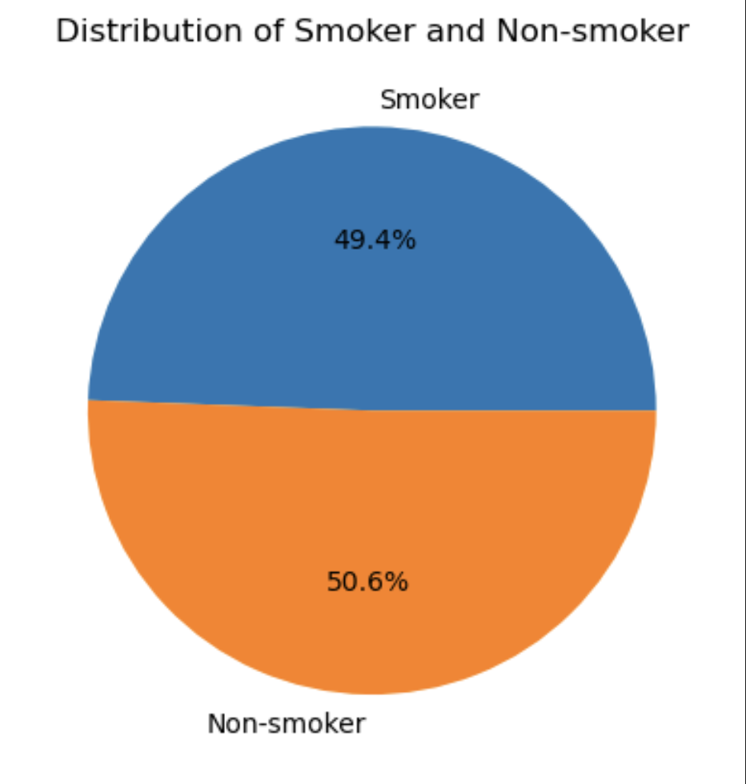
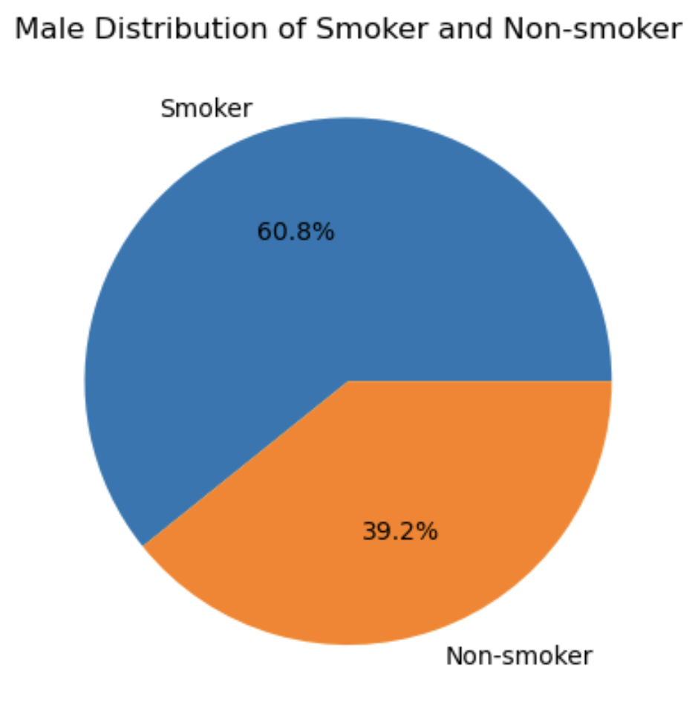
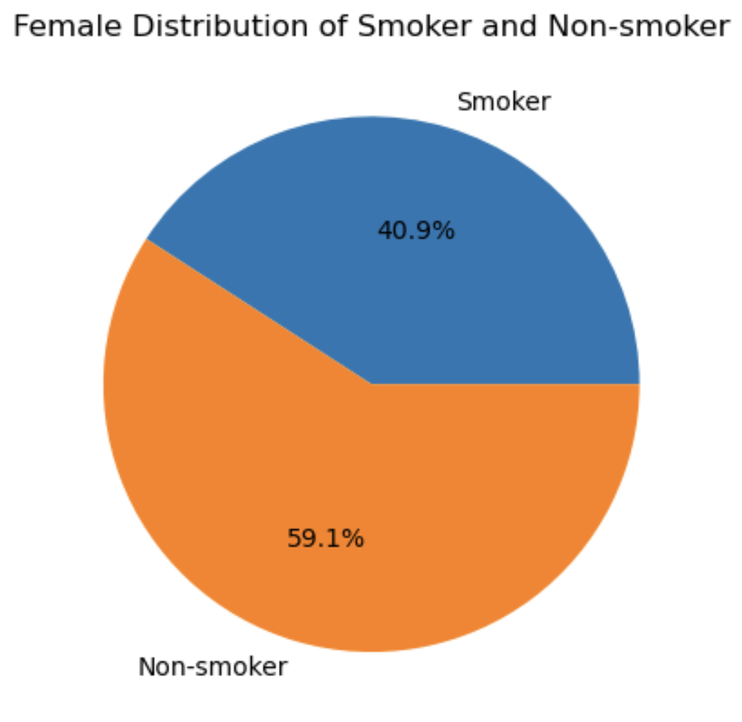
Cigarettes and Impact on Heart Disease
Hypothesis: Smoking Cigarettes increases your risk of developing Heart Disease
Population of Smokers Analysis:
T-test results: statistic=13.095, p-value=2.2043519152601072e-38, df=3931.305
Notes:
Our Hypothesis was that smoking cigarettes increases your risk of developing heart disease. We had an even split in non-smokers and smokers in the total population. When comparing smoking populations between males and females we can see that males are significantly more likely to smoke. This is proven with our t-test. There isn't enough data to make concise assumptions on why males are more likely to smoke but this is not random chance.

Slide 6
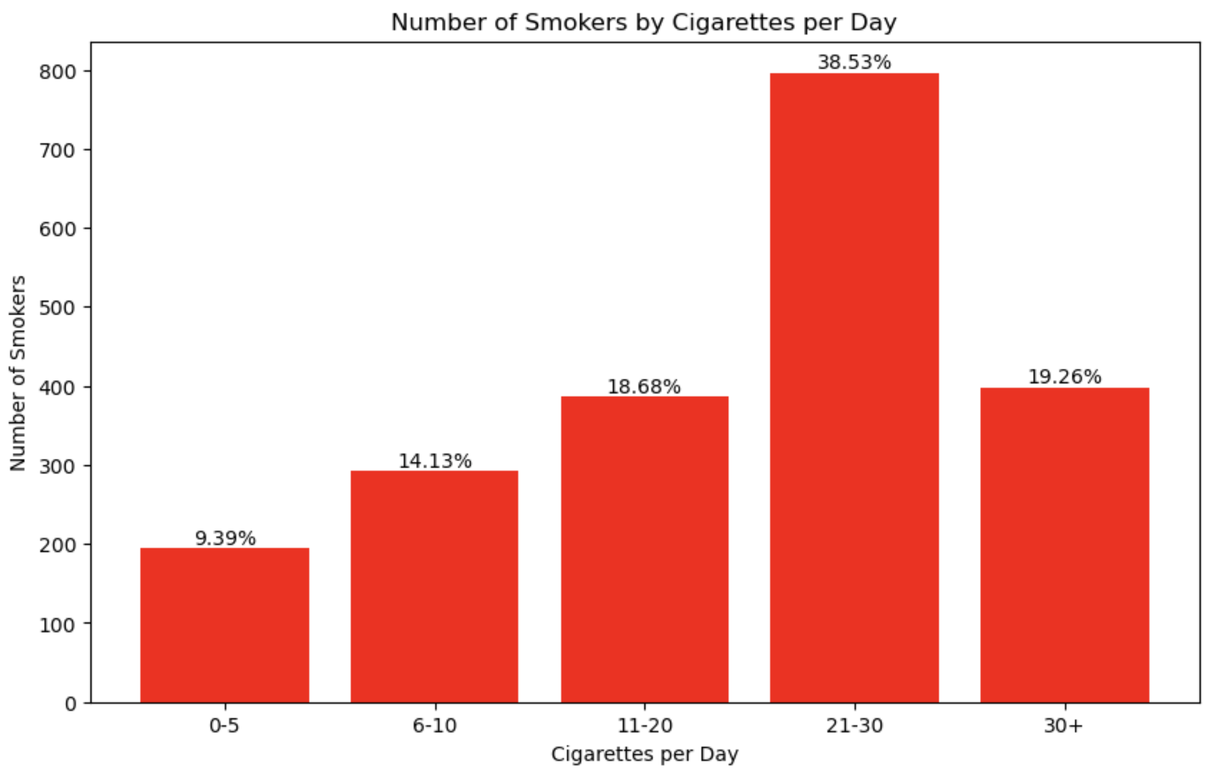
Smoker Population Analysis
Notes:
Our data set shows that our smoking population tend to be heavy smokers. We can see this by looking at the bar graph, most of the smoking population smokes more than 10 cigarettes a day. This gives a strong confidence in the fact that our population of smokers will have a significant impact on our analysis.
Seeing this got us curious. Is there a correlation between heart disease and how many cigarettes you smoke a day? The next slides are interesting finds our analysis.

Slide 7
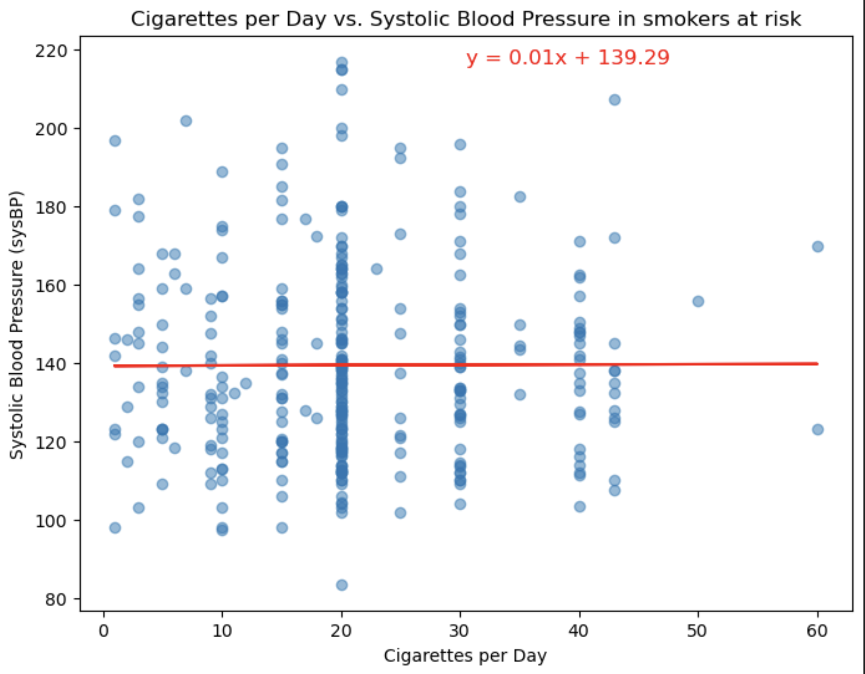
Notes:
Most of our graphs had moderate correlations except the following. All analyses can be found in our repo. There is no correlation to the number of cigarettes and systolic blood pressure. (quick slide)

Slide 8
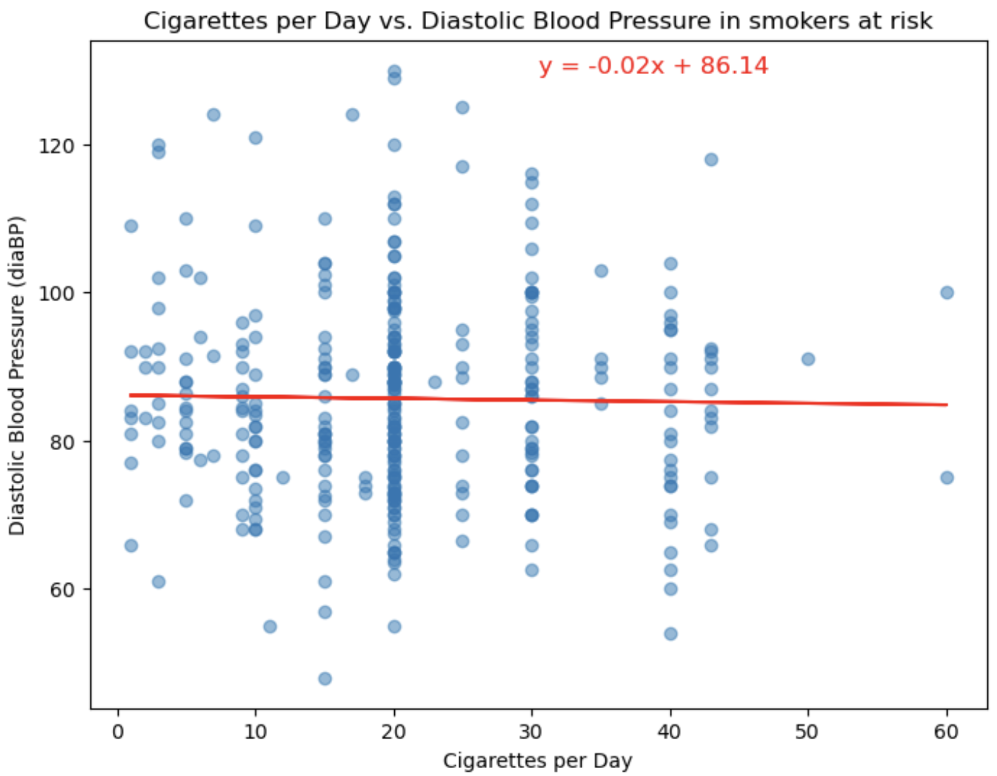
Notes:
Since linear regression correlation lines are mostly flat, we can comfortably say that the number of Cigarette someone smokes a day does not directly correlate with your blood pressure. Given this we wanted to see blood correlation in the non-smoker population. Age is a good common variable that can be related between the 2 populations.

Slide 9
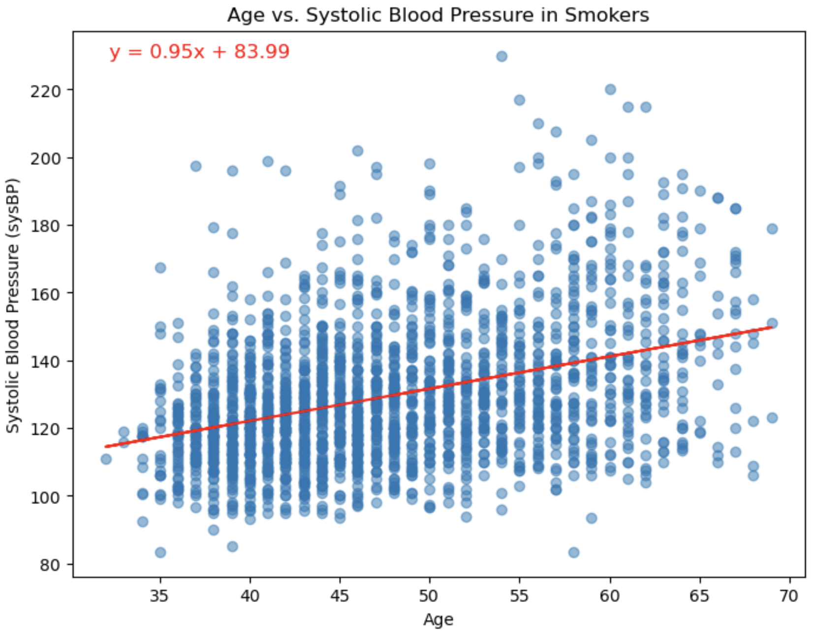
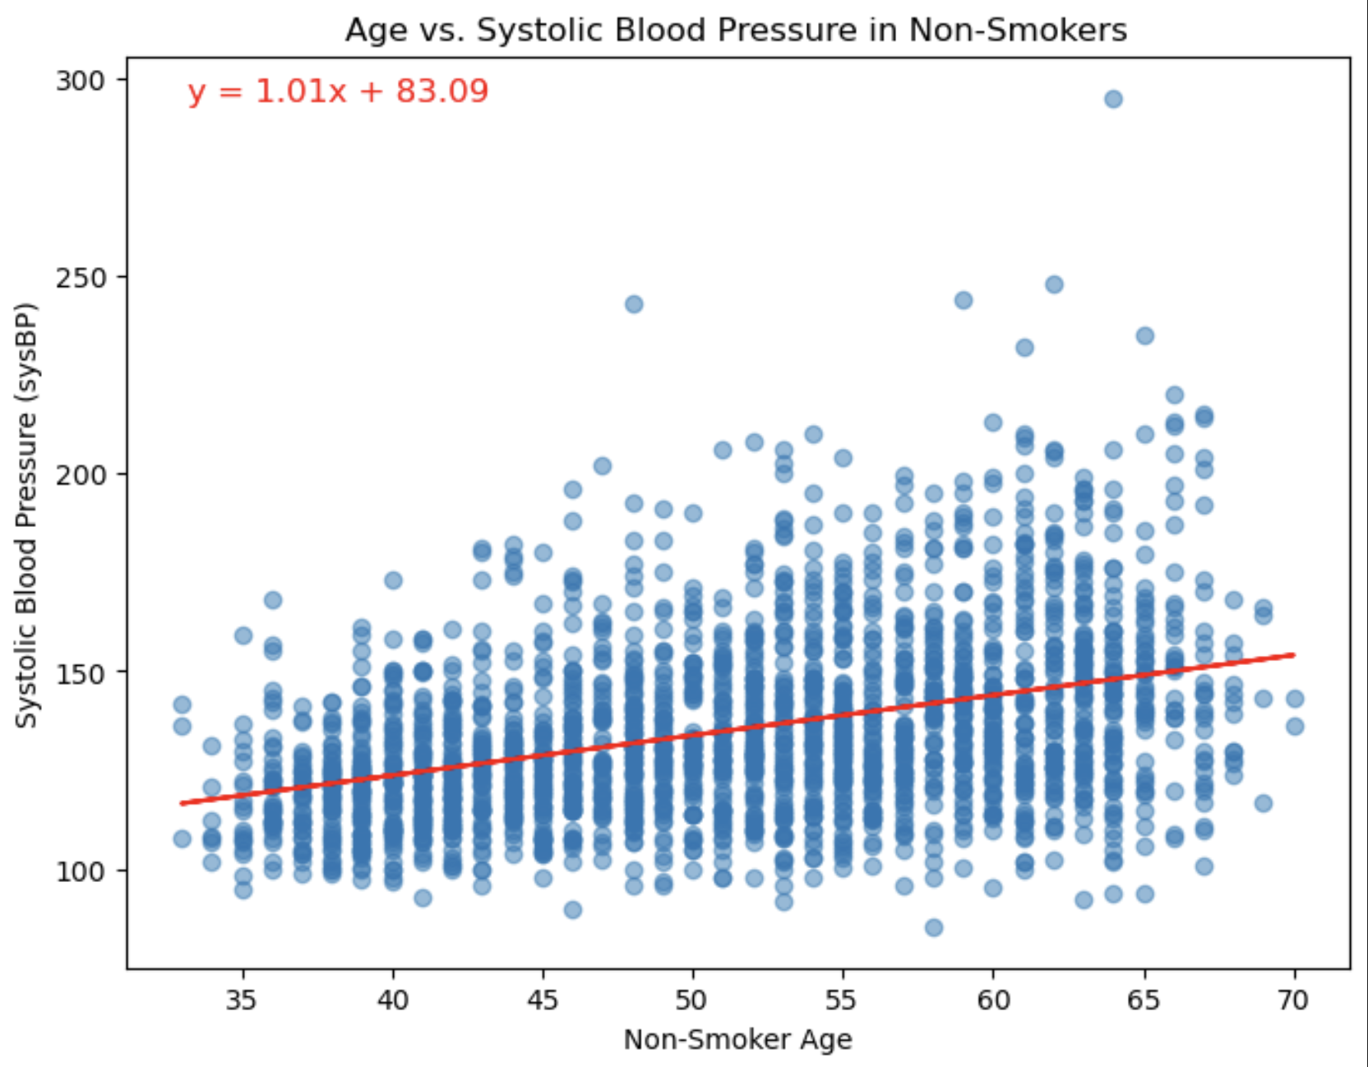
Notes:
There was a moderate correlation between Systolic blood pressure and age. This makes sense because the older you get the harder your heart works to pump blood throughout your body. (Quick Slide)

Slide 10
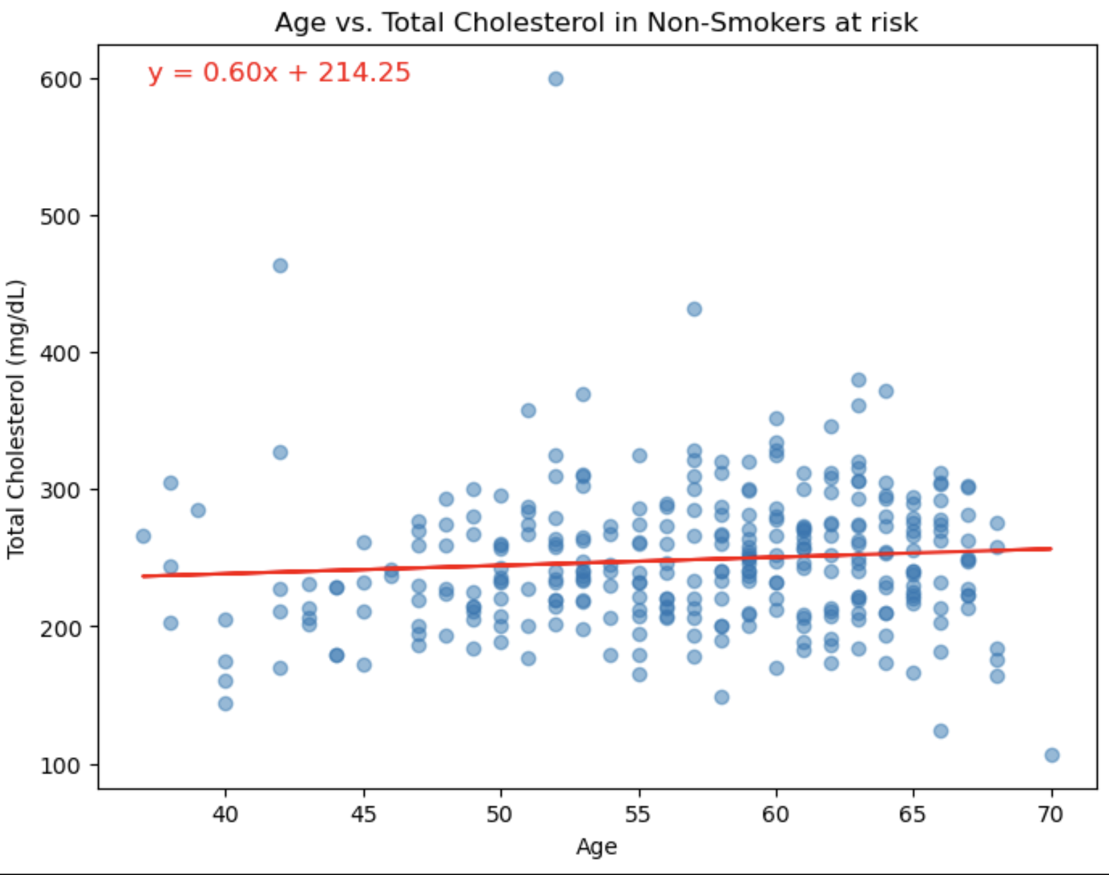
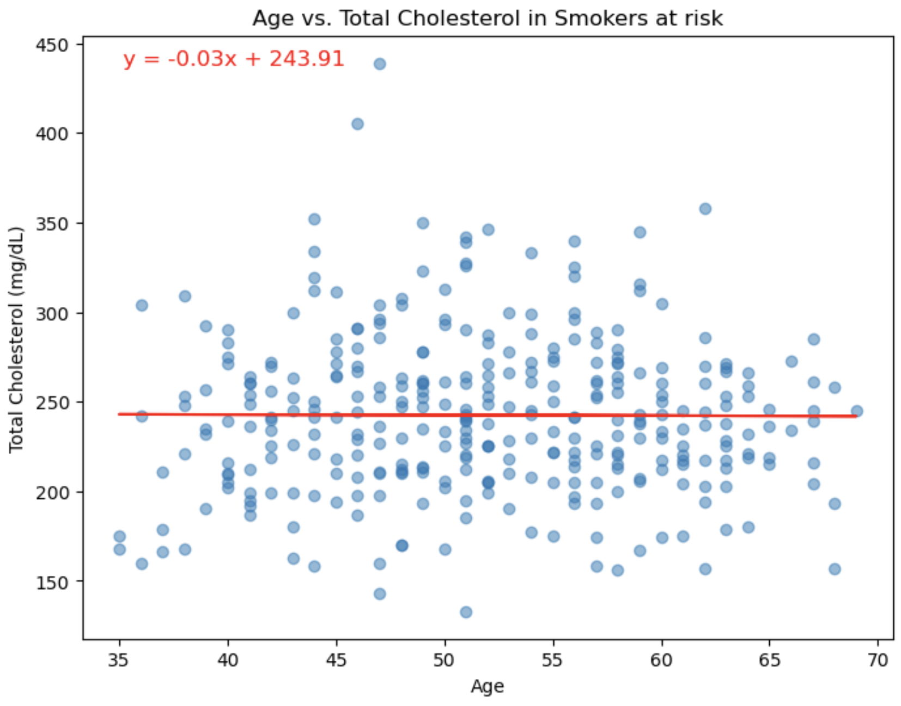
Notes:
Does smoking over time increases total cholesterol? We found out that there’s 2 kinds of cholesterol. Bad cholesterol and good cholesterol. Our data is limited because it measures total cholesterol. When comparing the at risk population, is didn’t matter if you smoked or not. Age had not correlated with total cholesterol when you were at risk for CHD.

Slide 11
Blood Pressure Results
The smoker populations Systolic BP avg is: 129.45 (Normal is 120 mmHg)
The smoker populations Diastolic BP avg is: 81.60 (Normal is 80 mmHg)
The non-smoker populations Systolic BP avg is: 135.24 (Normal is 120 mmHg)
The non-smoker populations Diastolic BP avg is: 84.27 (Normal is 80 mmHg)
T Test results for Systolic BP for smokers and non-smokers:
statistic = -8.36, p-value=8.66630797991092e-17, df=3845.39
T Test results for Diastolic BP for smokers and non-smokers:
statistic = -7.14, p-value= 1.1214772808032874e-12, df=3963.95
Notes:
Looking at the blood pressure we can see that the non-smokers tend to have a higher blood pressure on average then the smokers. While the dataset seems counterintuitive result calls for the fact that other health factors are affecting blood pressure in non-smokers. It also highlights the complexity of cardiovascular disease. Our T-tests have small p-values which shows that there is a significant difference in the populations.

Slide 12
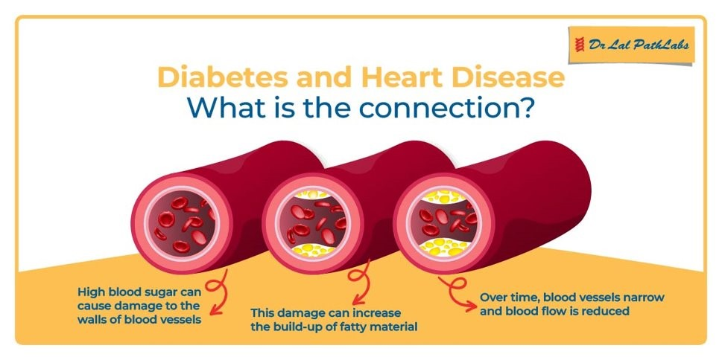
Diabetes and Heart Disease
What is Diabetes?
Commonly Known as sugar disease
Insulin not developed into the body system
Leading to various symptoms as liver malfunction, kidney problem, Heart Disease

Slide 13
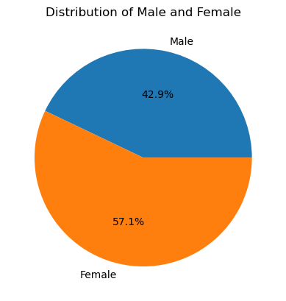
Diabetes and Heart Disease
Framingham Heart Study distribution
1st launched in 1948
Same geopolitical background Framingham, Massachusetts

Slide 14
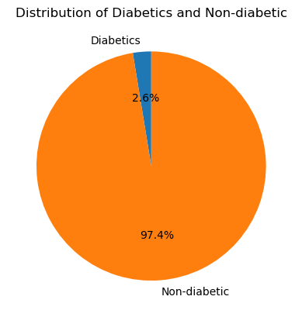
Diabetes and Heart Disease
From the population, the sample size is low for diabetic
Biologically Significant
Age group 32-70
Total Diabetic = 109
Non-Diabetic = 4131
Total Population = 4240

Slide 15
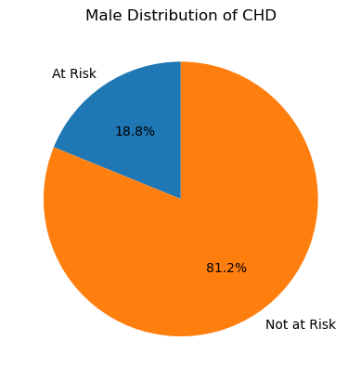
Diabetes and Heart Disease
Male total population : 1820
Total diabetic = 109
Male_Diabetic = 52
Male Non-Diabetic = 1768

Slide 16
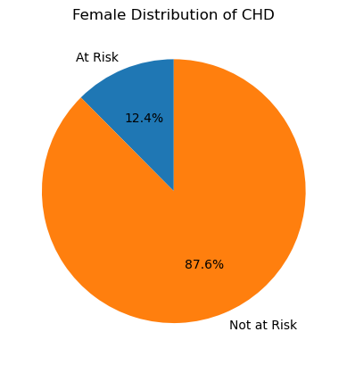
Diabetes and Heart Disease
Total female population : 2420
Diabetic : 57
Non- Diabetic :2363

Slide 17
Blood Pressure Medications and
Impact on Heart Disease
Key Variables:
Age, BP Meds and CHD
Age is distributed normally with Mean age of 49 and age ranges from 30 - 70 years

Slide 18
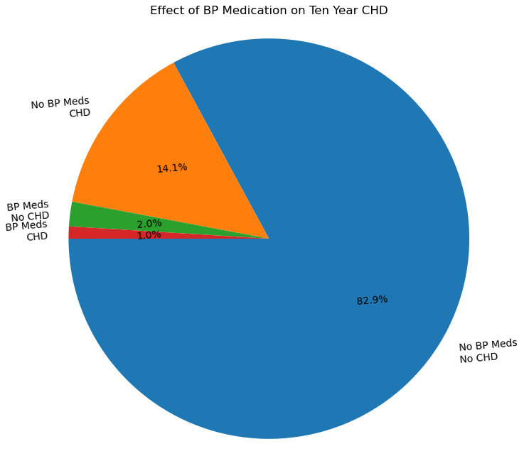
Among the overall population of 4187 individuals with info on BP Meds, the incidence of Ten Year CHD is approximately 15%
The dataset shows only 3% uses BP Medications
Hypothesis Testing - (T-test) - P-value on mean ages of 2 population with BP Meds and without meds resulted in 1.11e-14 < 0.05 - means that the age distribution of individuals on bp meds differs significantly from those not on bp meds

Slide 19
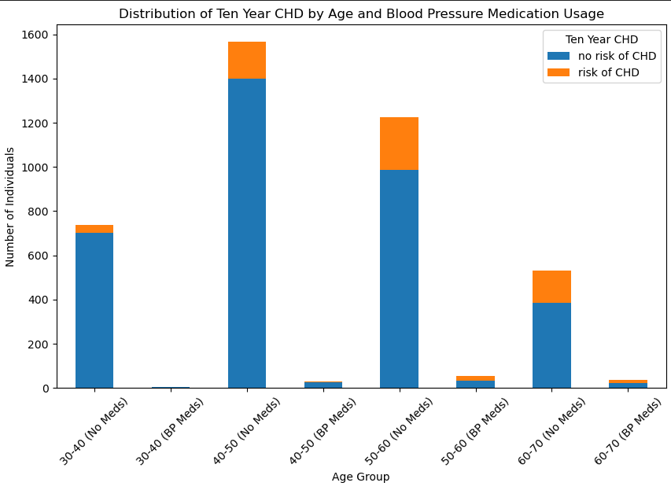
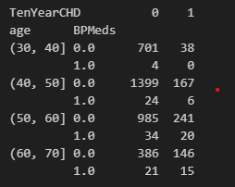
Chi-square statistic: 30.64 -High chi-square shows stronger association between the variables BP Meds and TenYearCHD
p-value: 3.09e-08 - Reject null hypothesis and can say that individuals taking BP meds may have a different risk of developing CHD compared to those not taking medication

Slide 20
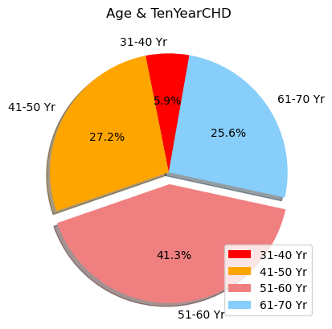
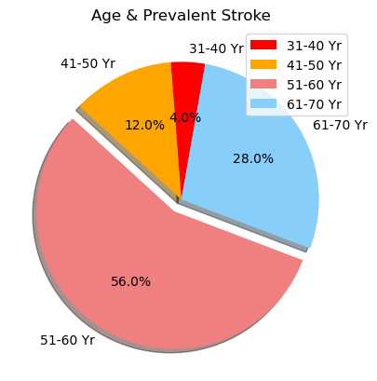
Impact of Age, Stroke, Hypertension on CHD

Slide 21
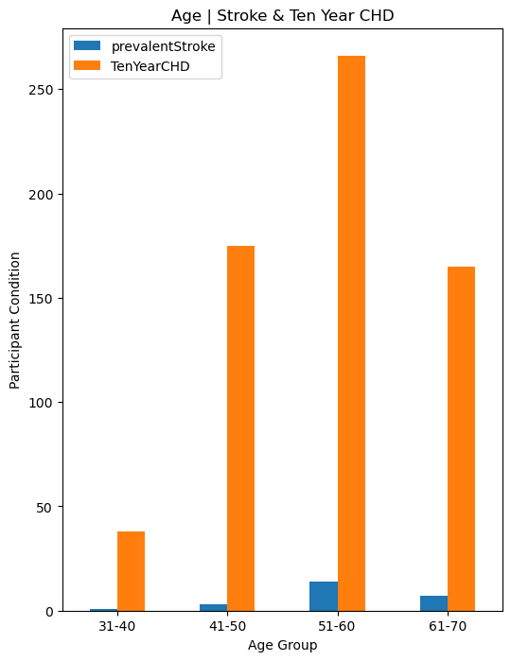
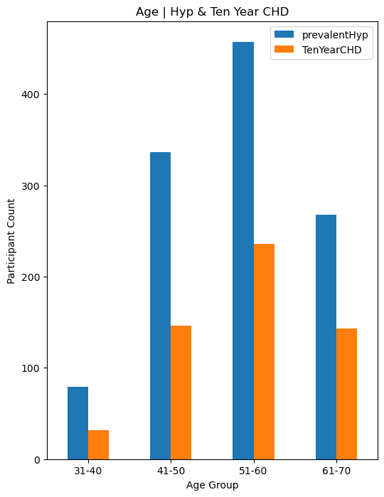
Impact of Age, Stroke, Hypertension on CHD
Findings:
Positive trend / alignment between Stroke, Hyp and risk of heart disease
As age increases from 31 - 60 years old, the percentage of stroke increases
While within age group 61 - 70 years old, the percentage of Stroke decreases significantly

Slide 22
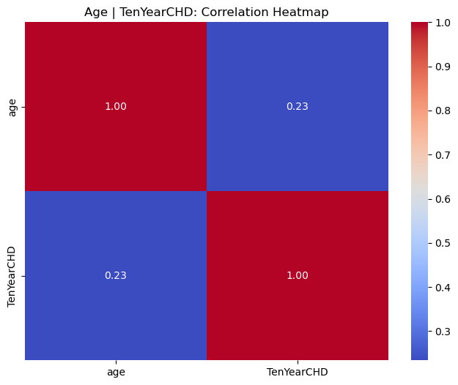

Correlations to TenYearCHD
Findings:
Age vs CHD: 0.23 correlation
2. Age vs Prevalent HYP: 0.31 correlation

Slide 23
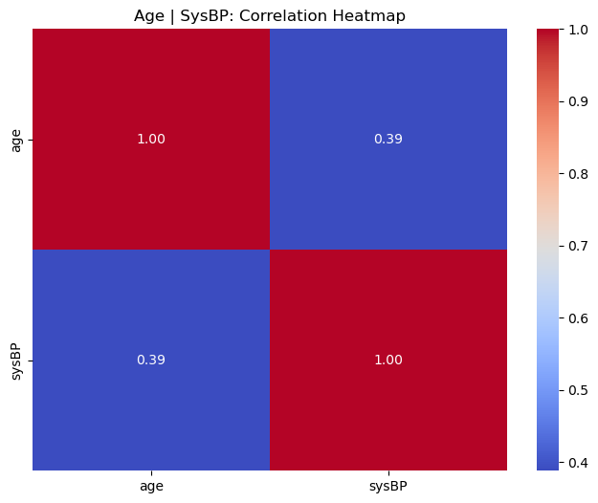
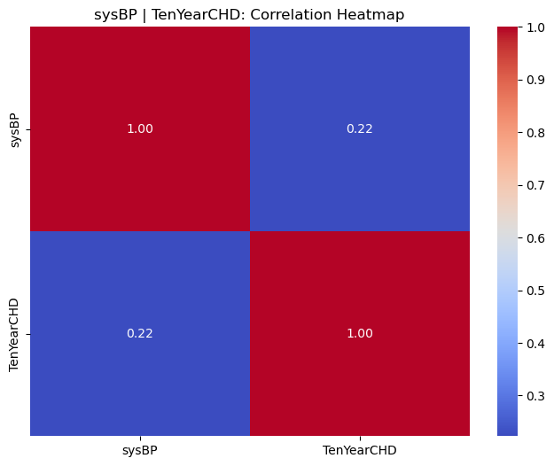
Correlations to TenYearCHD
Findings:
Age vs SysBP: 0.39 correlation
2. Systolic blood pressure vs CHD: 0.22 correlation

Slide 24
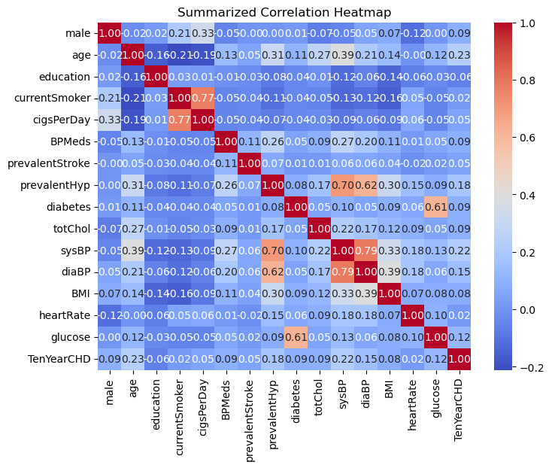
Summarized Correlations to TenYearCHD
Key take-away:
Age remains the largest factor this contributes to Ten Year Chronic Heart Disease

Slide 25
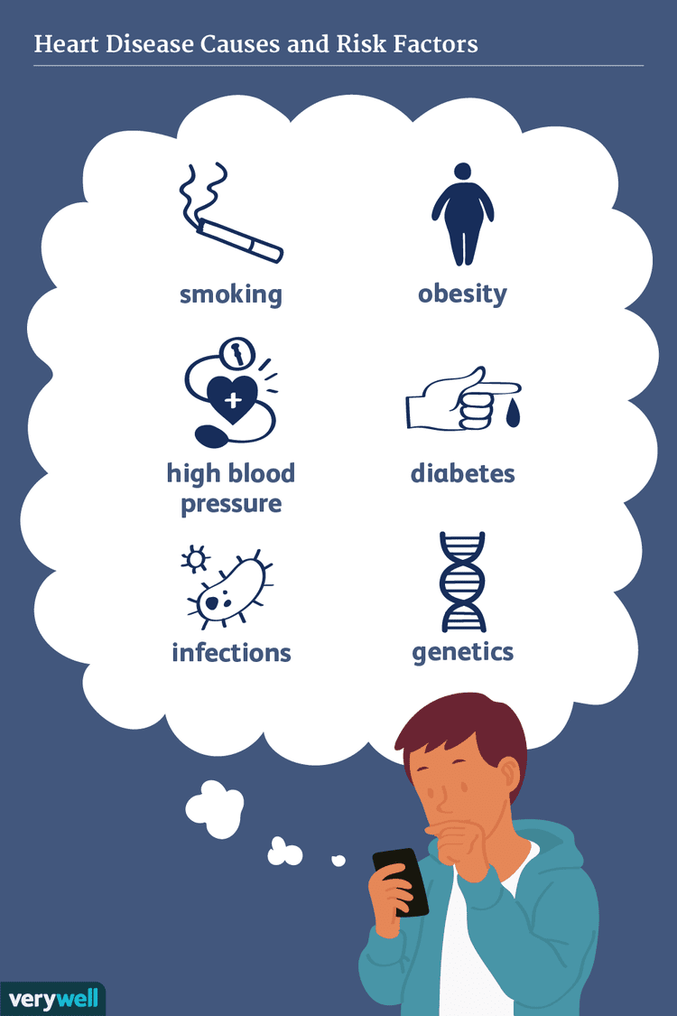
Limitations & Summary
Summary:
Age remains the largest factor this contributes to Ten Year Chronic Heart Disease
BP Meds play a notable role in the incidence of CHD as they may behave differently than who not take BP Meds
Ten Year CHD is positively correlated with Systolic blood pressure
In conclusion,, a handful of factors can contribute to the result of heart disease, and can be dedicated for education for prevention of cardiovascular diseases
Limitations:
Dataset contains an extensive amount of binary data, which could be difficult to visualize
Lack of good cholesterol vs bad cholesterol data
Given the limited age range in data population, unable to analyze cause of drop for Stroke, Hyp decreases in age 61 -70 compared to 51-60.
There’s a combination of factors leading to the increased ten year risk or outcome of CHD. The selected population lacks sufficient statistical support to conclude a single variable will result in TenYearCHD.
Next Steps :
Could evaluate difference between smoker and non-smoker by conducting a T-test calculation

Slide 26
Sources & References
* Github repo link: https://github.com/myhre062/heart-disease-analysis
1. Dataset Source: [Framingham Dataset]
(https://www.kaggle.com/datasets/aasheesh200/framingham-heart-study-dataset?select=framingham.csv)
2. Referenced Heatmap and Seaborn library
3. Contingency Table and Chi-Square Test:
a. [Chi-Square-Test-In-Python](https://medium.com/swlh/how-to-run-chi-square-test-in-python-4e9f5d10249d)
b. [Chi-square-python](https://pythonfordatascienceorg.wordpress.com/chi-square-python/)
4. American Heart Association:
https://www.uchicagomedicine.org/forefront/heart-and-vascular-articles/heart-month-3-steps-to-a-healthier-heart-right-now#:~:text=Cardiovascular%20disease%2C%20including%20stroke%2C%20is,preventable%20with%20education%20and%20action.
5. Media Sources:
https://www.verywellhealth.com/assessing-your-risk-of-heart-disease-1745752
https://www.salushomecare.com/blog/congestive-heart-failure/
tps://slideuplift.com/powerpoint-templates/thank-you-slide-01/

Slide 27



